Slide 1
Intersight Add-on for Splunk
An Introduction
Jeremy Williams, Technical Solutions Architect
August 2022

Slide 2
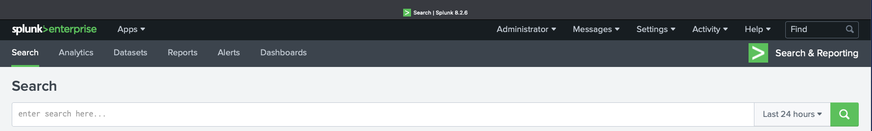
What is Splunk?
Splunk says…
“The data platform that helps turn data into action for Observability, IT, Security and more.”

Slide 3



Splunk Architecture
Data Collection
Index Tier
Search Tier
Handles data inputs such as modular or scripted inputs, network inputs, and HTTP Event Collector. Forwards data to indexers.
Sometimes called a Forwarder or Heavy Forwarder.
Handles data-manipulation functionality including parsing, indexing, and search. Indexes data, transforming raw data into events and placing results into an index.
Sometimes called an Indexer or Search Peer.
Handles search-time functionality, and includes dashboards, searches, macros, tags, lookups, data models, and other knowledge objects.
Sometimes called a Search Head.
Each function can be separated and scaled onto many servers in large environments or all functions can be combined onto a single server for very small environments.

Slide 4


Splunk Application Architecture
Add-On
App
An add-on is an application that provides specific capabilities to assist in gathering, normalizing, and enriching data sources.
An app is an application that runs on the Splunk platform. Apps are designed to analyze and display knowledge around a specific data source or data set.
The Add-on gets the data from Intersight into Splunk. That is available now.
The App provides pre-determined reports and dashboards. That has not been built yet.

Slide 5


Splunk Deployment Models
Traditional software distribution model.
Deploy the provided packages on your choice of server Operating System either on-premise or in the cloud.
Supports all Apps and Add-Ons.
As-a-Service model.
Splunk managed and deployed for the customer. Some differences in features and capabilities compared to Splunk Enterprise.
Supports a subset of published Apps and Add-Ons.

Slide 6
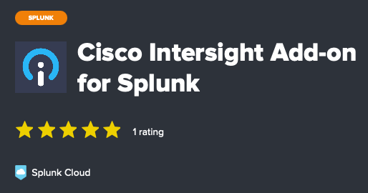
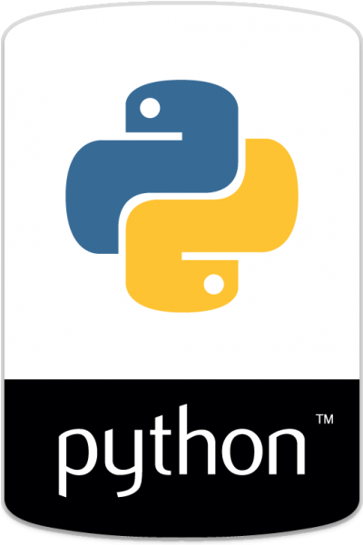
Cisco Intersight Add-on for Splunk
Compatible with Splunk Enterprise 8.0 or later
Compatible with Splunk Cloud
Published on Splunkbase (the Splunk app store)…
https://splunkbase.splunk.com/app/6482/
Also published on GitHub…
https://github.com/jerewill-cisco/intersight-splunk-addon
Documentation, examples, troubleshooting, and more are available at the GitHub repository.
Written in Python targeting the 3.7 release

Slide 7
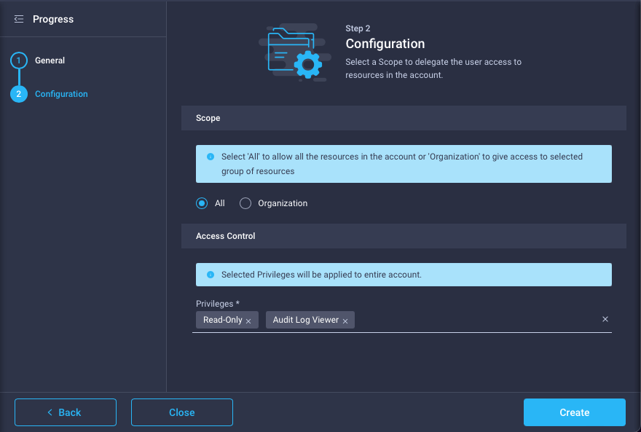
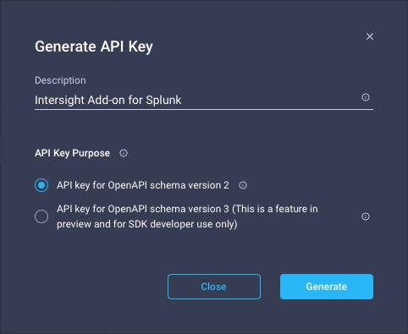
Cisco Intersight Add-on for Splunk
Data is retrieved from Intersight using the REST API and an Intersight API Key
Most of the functionality will work with an API key having the system defined Read-Only role. But to get the Audit Logs while maintaining a least privilege access model, I suggest that creating a custom role that includes the Read-Only and Audit Log Viewer privileges.

Slide 8
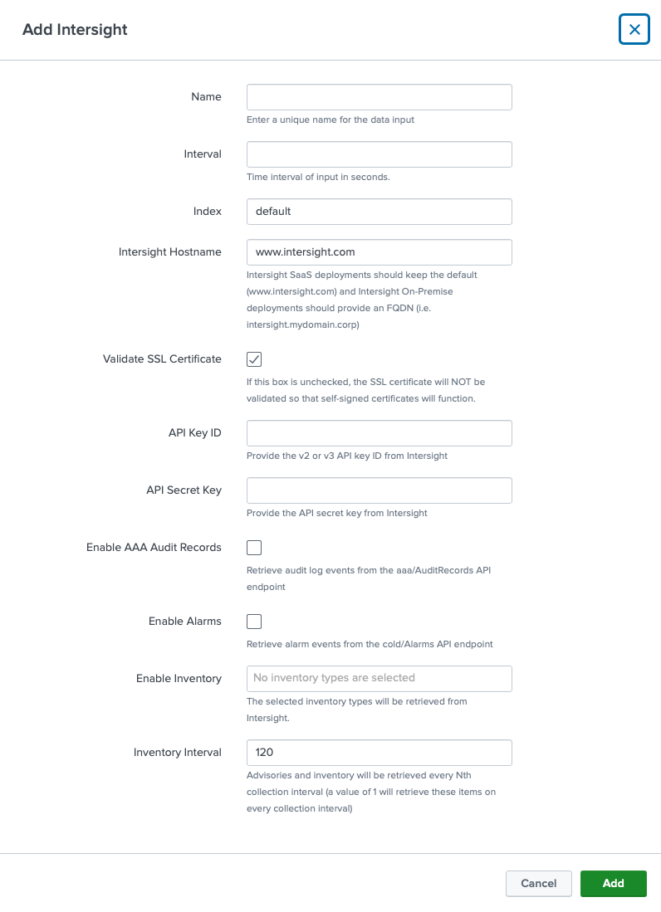
Cisco Intersight Add-on for Splunk
The Add-on’s primary function is to provide a python scripted input that retrieves data from Intersight.
Either SaaS or On-premise appliance deployments of Intersight are supported
Various data types are selectable in the input
Multiple instances of the inputs are supported to gather data from any combination of Intersight SaaS and On-Premise accounts

Slide 9
Examples

Slide 10
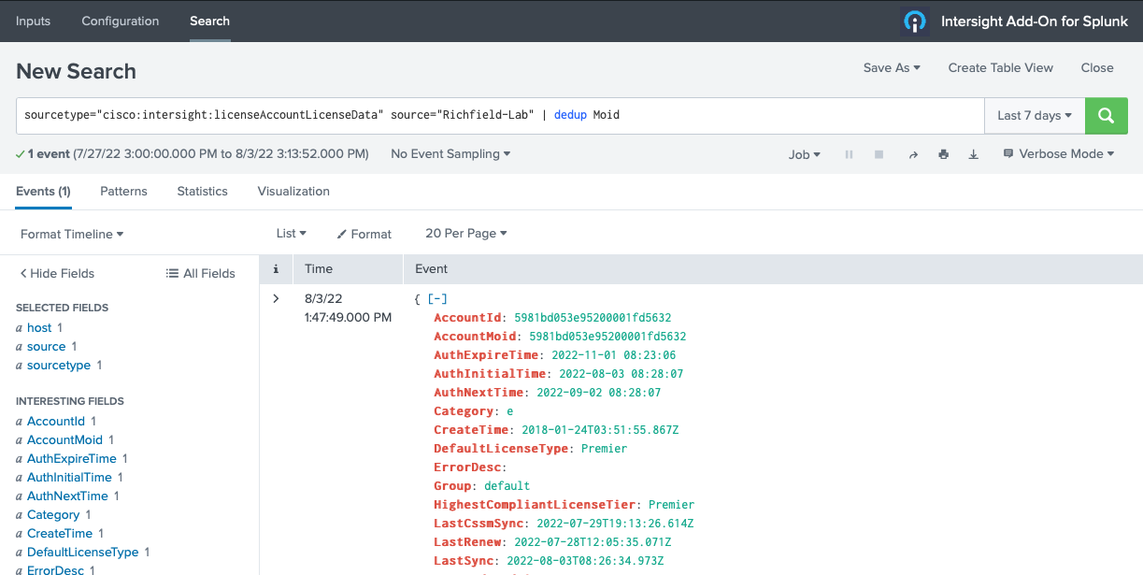
Notes:
Here we can see a licenseAccountLicenseData record from Intersight in Splunk. The native JSON formatting from the API is preserved and fields are extracted automatically.

Slide 11
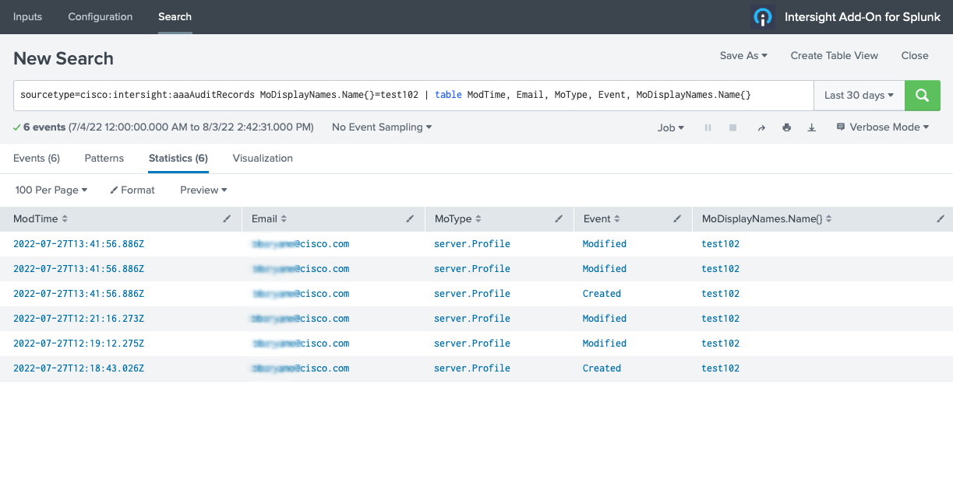
Notes:
Here we can search and report on activity from the aaaAuditRecords sourcetype.

Slide 12
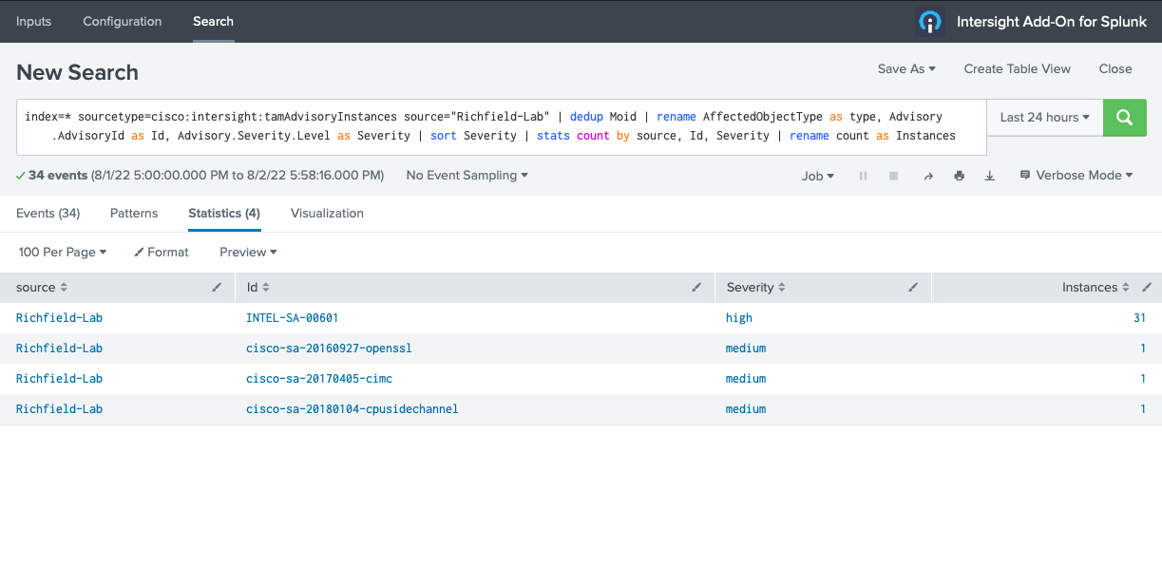
Notes:
Here we can search and summarize the Advisory records from Intersight. We can see that the INTEL-SA-00601 advisory is affecting 31 servers.

Slide 13
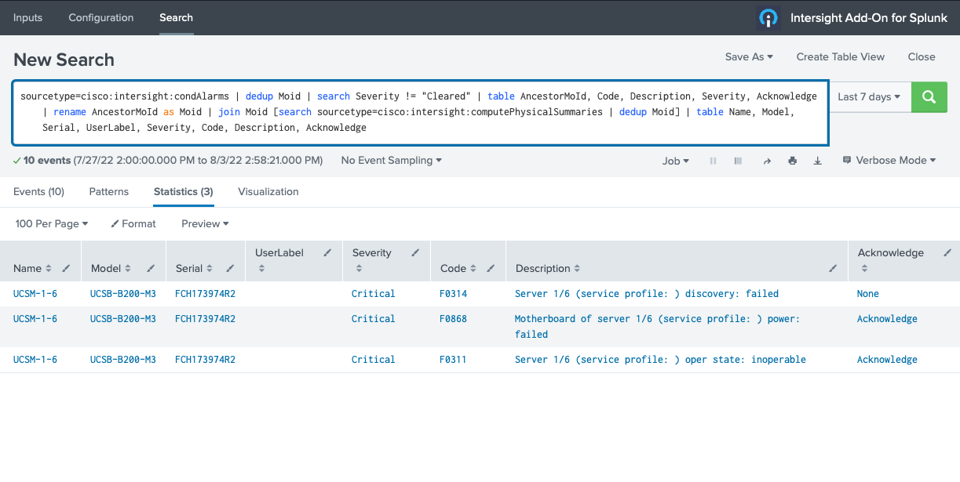
Notes:
Here we report on Alarms. We can combine data from the condAlarms sourcetype with data from the computePhysicalSummaries sourcetype to provide a correlated view.

Slide 14
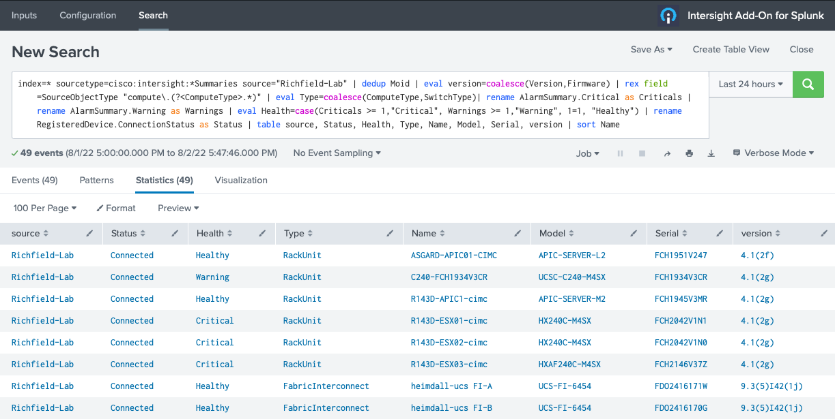
Notes:
Here we report on inventory in a combined way. We put together compute and network sourcetypes and calculate a Health column from the AlarmSummary object.

Slide 15
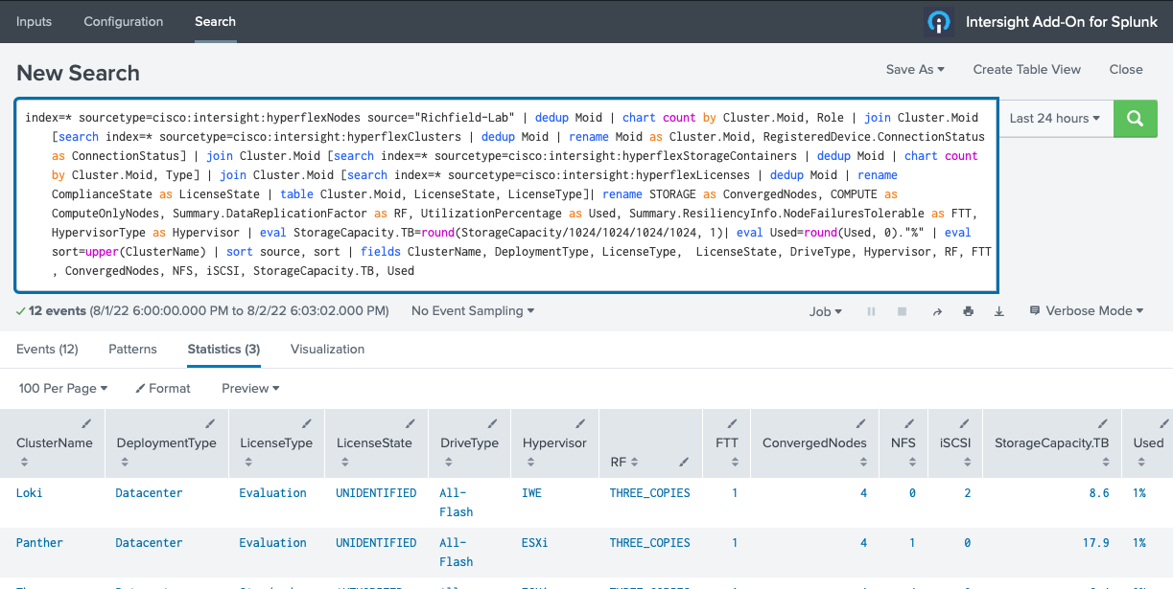
Notes:
Here we pull together many sourcetypes for a report on Hyperflex clusters.

